Slide 1
The Role of Tool Support
in Public Policies and Accessibility
Fabio Paternò, Antonio Giovanni Schiavone
CNR-ISTI, HIIS Laboratory
Pisa, Italy
Notes:
CHI 2011 Course Notes 1 Siegel

Slide 2
HIIS Laboratory Focus: Usability and Accessibility
Usability and Accessibility are tightly related to each other
Accessibility aims at increasing the number of users
Usability aims at making users more efficient and satisfied
Usability without accessibility, there are users who cannot access some information
Accessibility without usability, all users can access but at least some with difficulties

Slide 3
Why Automatic Tool Support
It reduces the costs and efforts for evaluation
It increases consistency in the identification of the problematic parts
It increases the types of features that can be evaluated
Automatic tools can provide support in various phases: capture of user behavior, analysis of implementation, support for redesign

Slide 4
Why Public Policies should support more automatic tools adoption?
They have limitations, but …
Even expert manual validation has critical issues:
Experts are more accurate but require more time to validate sites with many pages
Automatic tools can help in detecting most common and frequent errors thus reducing their workload and allow them to focus on more sensitive aspects
User testing is limited to consider specific users while validators can handle specific problems of group of users
Public policies should also provide guidance on how to ensure accessibility is maintained over time

Slide 5
The new scenario
There are many international (W3C) and national (Section 508 / Stanca Act / …) guidelines
Are these enough for universal usability?
Need for guidelines providing integrated support for usability and accessibility for specific classes of users or domains or cultures
Need for automatic tool support for design and evaluation

Slide 6
Guidelines for Visual-impaired Users
Issues with assistive technologies: lack of page context perception, information overloading, sequential reading
They can be addressed through page organization and structure; content appropriateness; multimodal support, consistency …
Result in a user study with two Web sites (one with basic accessibility support and one with our guidelines):
on average about 37% navigation time saved
More information:
B. Leporini, F. Paternò, “Applying Web Usability Criteria for Vision-Impaired Users: Does It Really Improve Task Performance?”, International Journal of Human-Computer Interaction, Volume 24, Issue 1 January 2008, pp. 17-47.

Slide 7
Accessibility Validators
They are software able to check in a automatic or semi-automatic way whether requirements indicated by the guidelines are supported by the implementation of the application considered
They are available usually on line, sometimes as desktop application or plugin for browser
They are usually developed by considering 2 - 3 sets of guidelines, and are difficult to update for addressing new guidelines or requirements
Various of them have soon became obsolete and of little utility.
The W3C maintains a list of tools at http://www.w3.org/WAI/ER/tools/

Slide 8
Requirements for automatic support
Applicability to technologies (HTML, CSS, …) and pages or sites
Expandability and upgradeability
Alignment with the latest technology
Limited effectiveness of the reports for all the various roles (developers, designers, public officers, …)

Slide 9
Guideline independent support
Easily add new guidelines, modify or delete existing ones
Define and use different sets of guidelines
Separate tool implementation from the definition of guidelines
Avoid repetitive recoding of the tool by the implementers

Slide 10
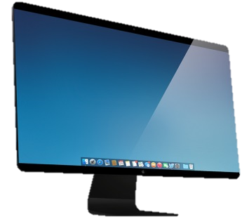
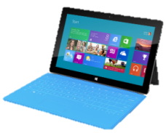
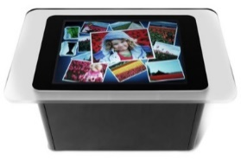
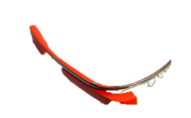
Technological trends: Device Fragmentation
Personal Computers (PCs) usually vary between 800x600 and 1920x1200 pixels
Mobile devices usually between 320x240 and 1920x1080 pixels (Iphone 6 plus) – 2560*1440 (Galaxy S 6)
Public Displays are becoming cheaper and cheaper
Smartwatches (e.g. Gear S 2.0” 360x480)

Slide 11
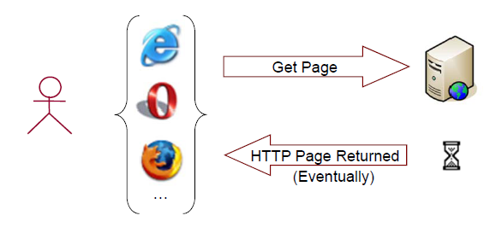
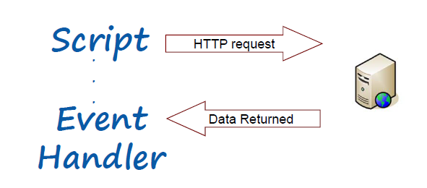
Technological trends: Web site evolution
From sets of pages connected through links …
… each page is a set of files (html, css, javascript) whose content can be dynamically changed (for example google suggest)
Traditional Approach
Modern Dynamic Approach

Slide 12
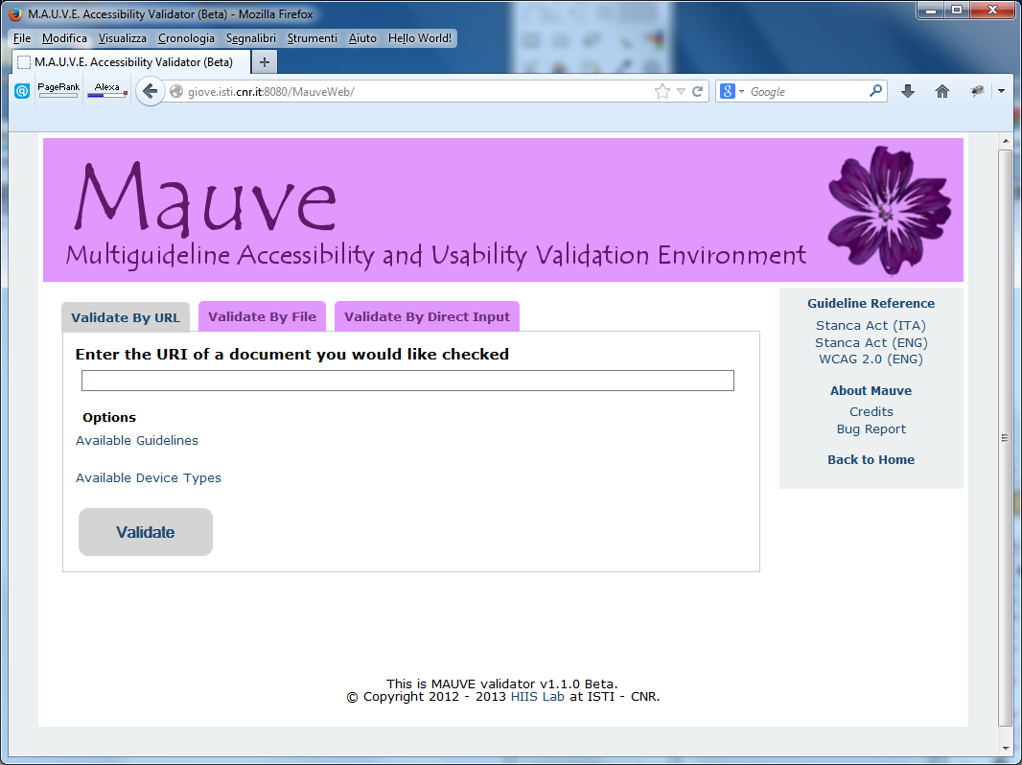
Multiguideline Accessibility and Usability Validation Environment (MAUVE)
Guidelines coded through a formalization language and externally stored as XML files. Guidelines’ repository is easy to expand and/or upgrade.
Ability to validate up to 5 device-specific versions of a website (Desktop, Tablet, Smartphone, Video Game Console, Smart TV).
Dynamic websites’ validation through browsers’ plugins.
Web developers-oriented report system, with indications of the accessibility’s problems directly into web page’s source code.
HTML5 and CSS3 compliant.
Web page’s selection by URL, file upload or source code direct input.
Web page’s validation against user’s custom guidelines (if compliant with our formalization language).
On the report page, direct link to the documentation for the detected problems.
Freely available at
http://hiis.isti.cnr.it:8080/MauveWeb/

Slide 13
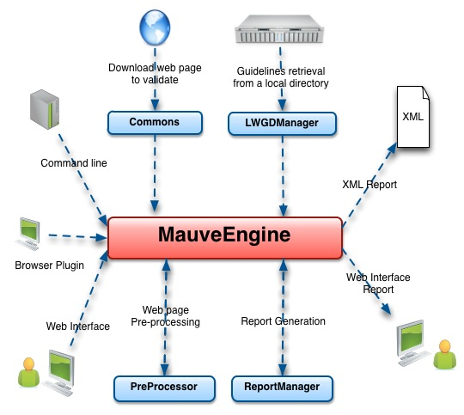
MAUVE Architecture

Slide 14
MAUVE Demo

Slide 15
Conclusions
Various years since the appearance of the first validators but their adoption is not yet fully addressed in public policies
Even if they are not able to provide complete analysis they are fundamental in making the validation process more efficient, consistent, and reliable
Guidelines-based evaluation can provide personalized results for specific user types, application domains, cultures
Public services are becoming more and more provided through the Web
Public administrations have the duty to support all citizens giving everyone the same quality of services

Slide 16
References
Paternò, F. and Schiavone A. G., "The role of tool support in public policies and accessibility." ACM Interactions 22.3 (2015): 60-63. DOI: 10.1145/2745395
Schiavone, A. G. and Paternò, F., "An extensible environment for guideline-based accessibility evaluation of dynamic Web applications."Universal Access in the Information Society 14.1 (2015): 111-132. DOI: 10.1007/s10209-014-0399-3

